Slide 1
Fraudulent Claim Detection
Astha Bansal
Ashwini Agalave

Slide 2
Problem Statement
Global Insure, a leading insurance company, processes thousands of claims annually. However, a significant percentage of these claims turn out to be fraudulent, resulting in considerable financial losses.
The company’s current process for identifying fraudulent claims involves manual inspections, which is time-consuming and inefficient. Fraudulent claims are often detected too late in the process, after the company has already paid out significant amounts.
Global Insure wants to improve its fraud detection process using data-driven insights to classify claims as fraudulent or legitimate early in the approval process. This would minimize financial losses and optimize the overall claims handling process.

Slide 3
Agenda
Data cleaning and Processing
EDA on Training Data
Feature Engineering
Model Building
Prediction and Model Evaluation
Evaluation and Conclusion

Slide 4
Features of the Dataset
The insurance claims data has 40 Columns and 1000 Rows, 38 features:
13 numerical features
25 categorical features
One Target Variable: Fraud_Reported
Yes – 247 Count
No – 753 Count
Target variable demonstrates High Class Imbalance. Important to take care of this during modelling.
Dataset split into Train and Test set for modelling purpose. Train set had 800 datapoints. Test set had 200 datapoints.

Slide 5
Data Cleaning and Processing

Slide 6
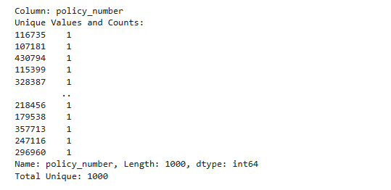
Changing dtypes and Dropping columns with Unique Values
Data cleaning involves cleaning, transforming, and engineering features from the raw claim data to ensure the model can learn effectively.
Handling null values, drop the redundant data and find unique values and fixing data types

Slide 7
Exploratory Data Analysis

Slide 8
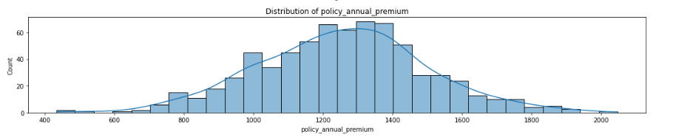
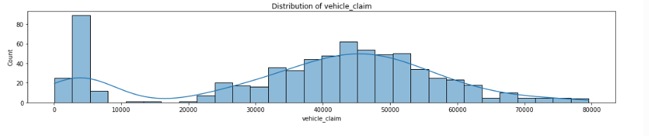
Distribution of policy_annual_premium and vehicle claim

Slide 9
Feature Selection

Slide 10
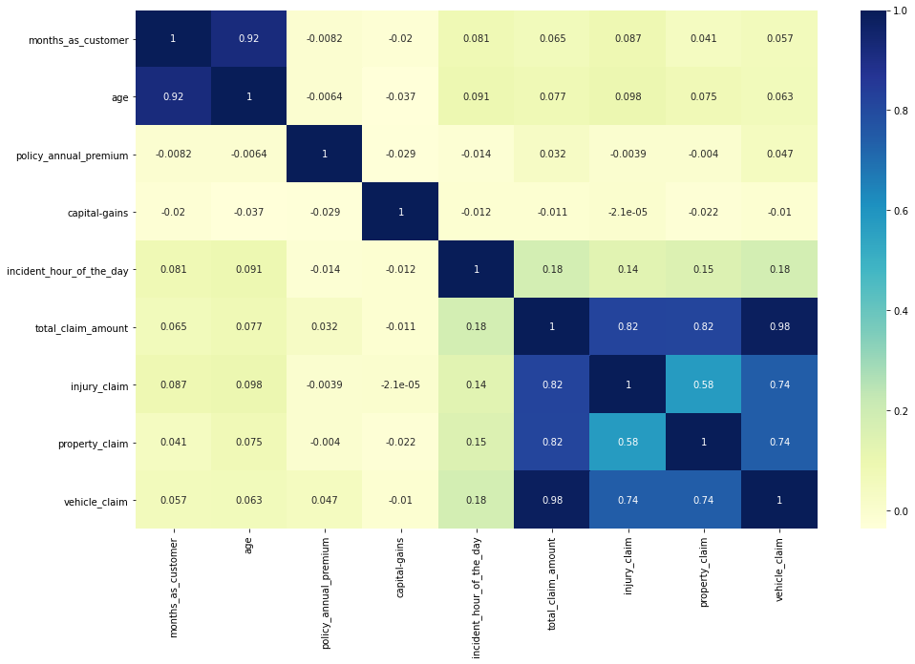
Correlation Amongst Numerical Features
Strong Positive Correlations:
total_claim_amount shows high correlation with:
injury_claim (0.82)
property_claim (0.82)
vehicle_claim (0.98)
This indicates that total_claim_amount is largely composed of these three component claims, as expected.
Multicollinearity Alert:
months_as_customer and age are very highly correlated (0.92). This suggests that older customers tend to have been with the company longer. Consider dropping one of them to avoid multicollinearity in models.

Slide 11
Models and Approaches

Slide 12
Models Used
After removing correlated features and features with unique values, we have 30 features in the dataset:
9 Numerical Features
21 Categorical Features
Predictive Model used is Logistic Regression Model and Random Forest Model
1. Logistic Regression Model
Used RFECV for feature selection and built a logistic regression model.
2. Random Forest Model
Built a random forest model and obtained feature importance scores.
Performed hyperparameter tuning using grid search to optimize model performance
RandomForestClassifier gave best performance, so results for that have been shown.

Slide 13
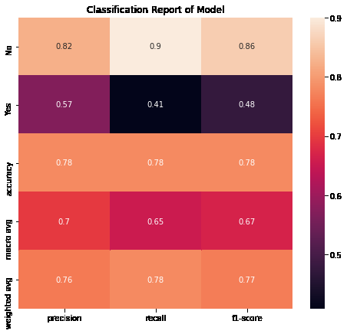
Base model performance
The Base model performed fairly well on rightful claims, but not so great on the fraudulent claims.
This shows the need to hypertune the model, by giving more weight to the underrepresented class. Could also be the case of overfitting on training dataset.

Slide 14
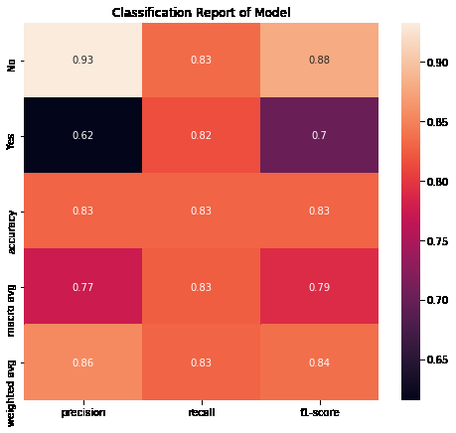
Model Tuning
Model performance has vastly improved because of hyperparameter tuning.
Recall for both classes is above 80%.
From a business point of view, recall of fraudulent class should be one, so still room for improvement.

Slide 15

Model Performance with important features
Model performance with selection of only important features has improved slightly more
F1-Score has increased from 0.84 to 0.85

Slide 16
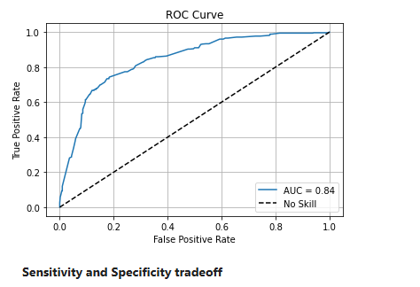
ROC AUC Curve
ROC AUC Curve shows how well the model has been able to separate out the classes
ROC AUC Score of 0.84 shows the model has done a good job, but there is room for improvement.

Slide 17
Insights and Business Decisions
Claims to be targeted:
Having atleast one witness
Insured has a hobby of Chess or CrossFit
Insureds listing their occupation as Exec- Managers
Insureds reporting claims for major damage
Claim amount and insured education level are also important features as evidenced by model feature importance

